Slide 1
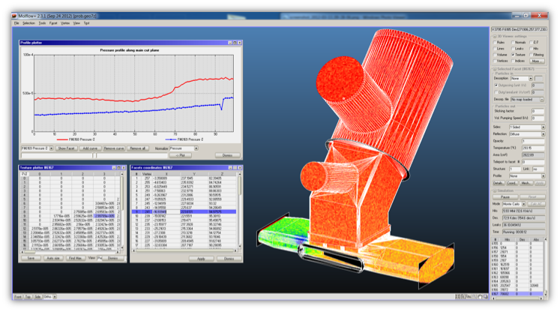
Molflow tutorial
Monte Carlo simulation of ultra high vacuum systems
2020.10.07, Roberto Kersevan, Marton Ady

Slide 2
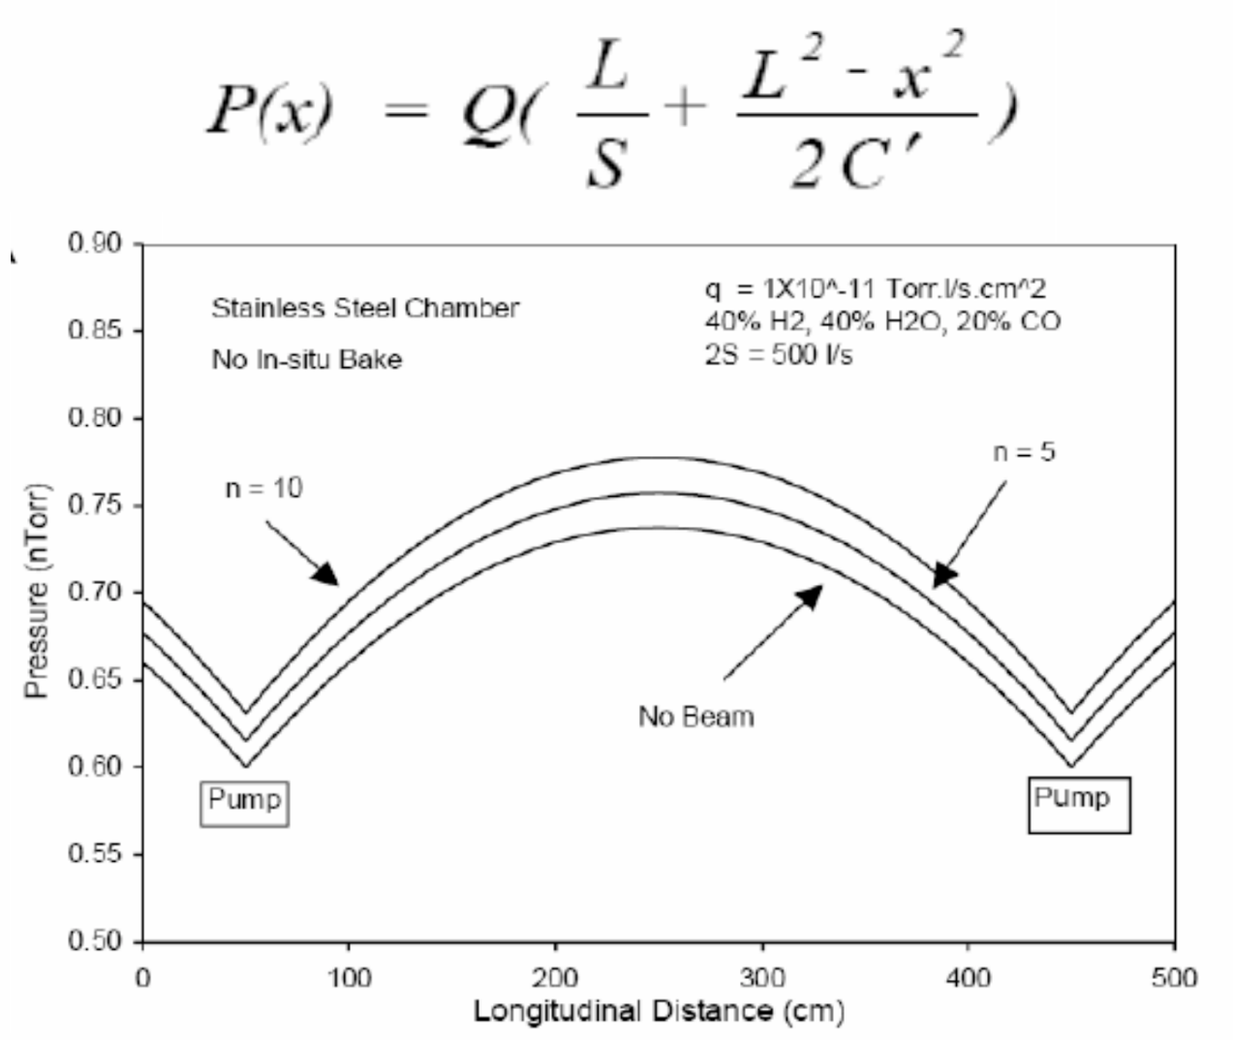
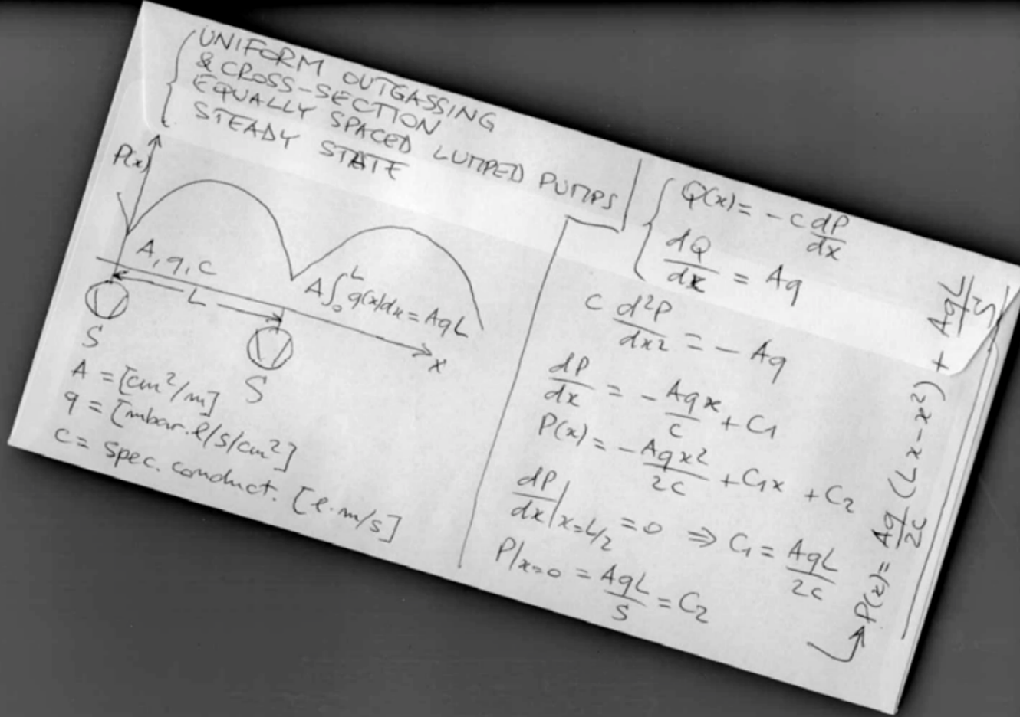
Vacuum calculations: analytic method
A
L
S
S
S
P=Q/S
Q=C*(p₁-p₂)

Slide 3
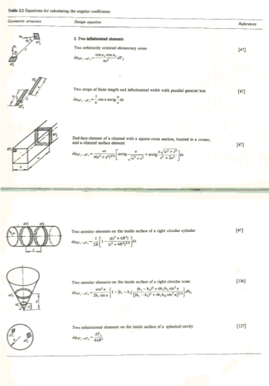
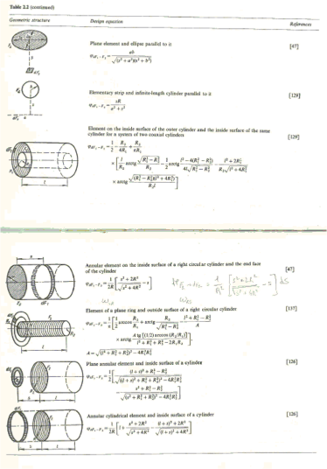
Difficulty: Conductance

Slide 4
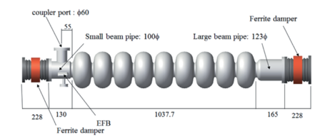
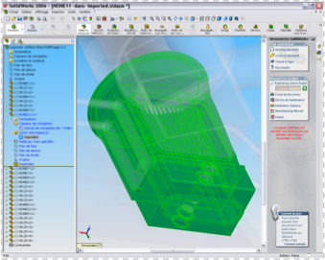
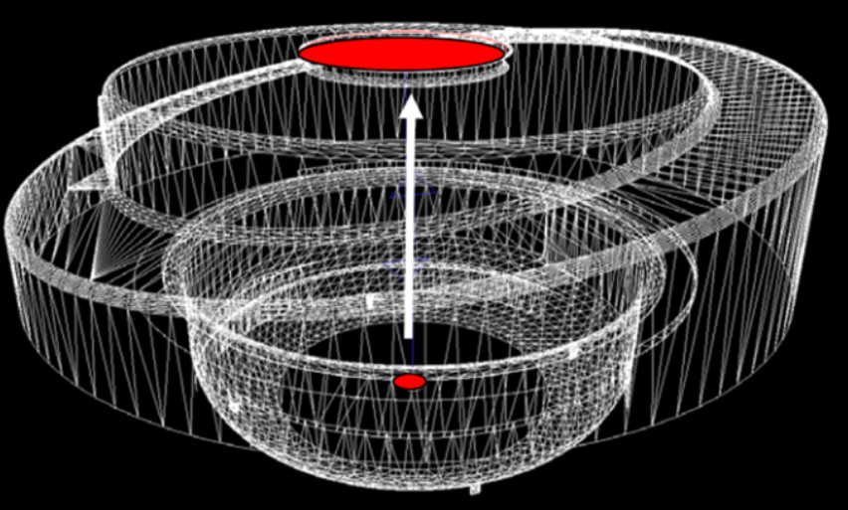

Slide 5
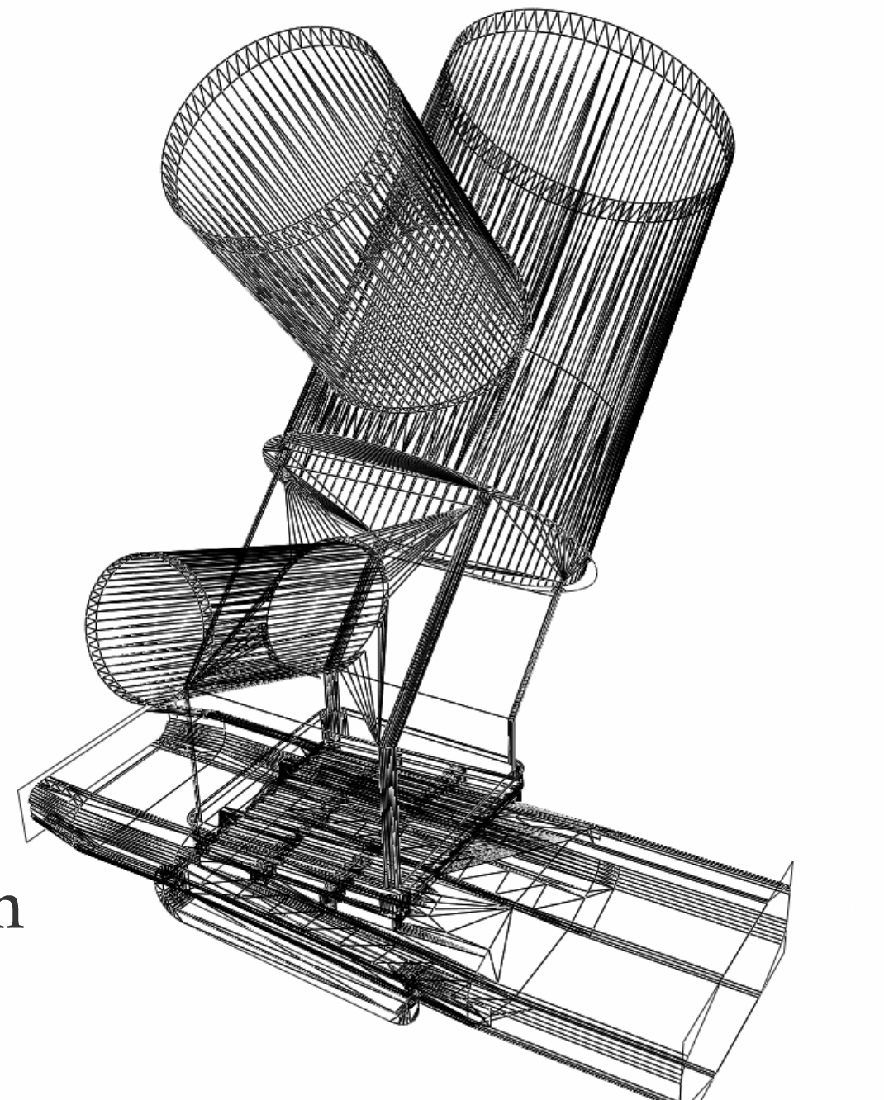
Monte Carlo simulations
Geometry: polygons
Gas input:
pV=NkT
1 Pa*m³/s = 2.4*10²⁰ molecules/s
Virtual / Physical particle ratio

Slide 6
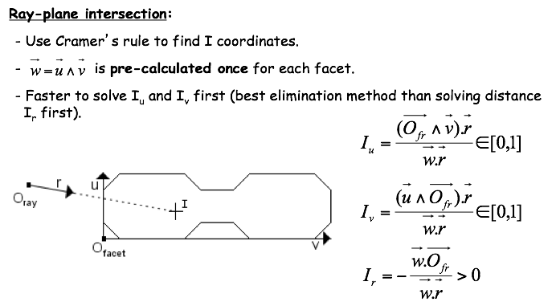
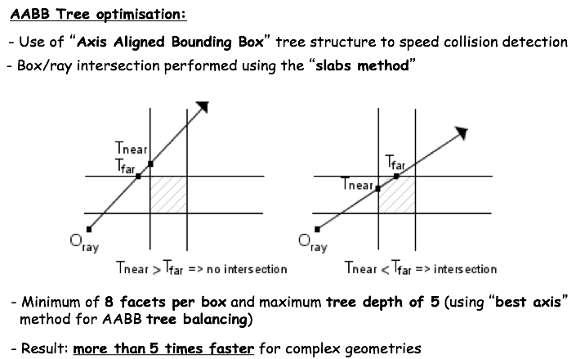
Ray tracing

Slide 7
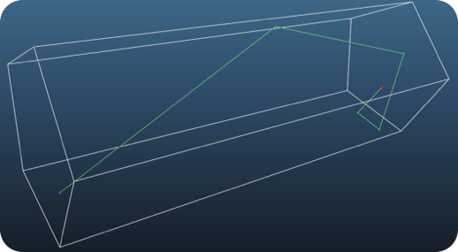
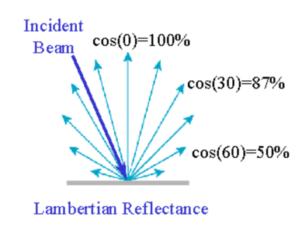
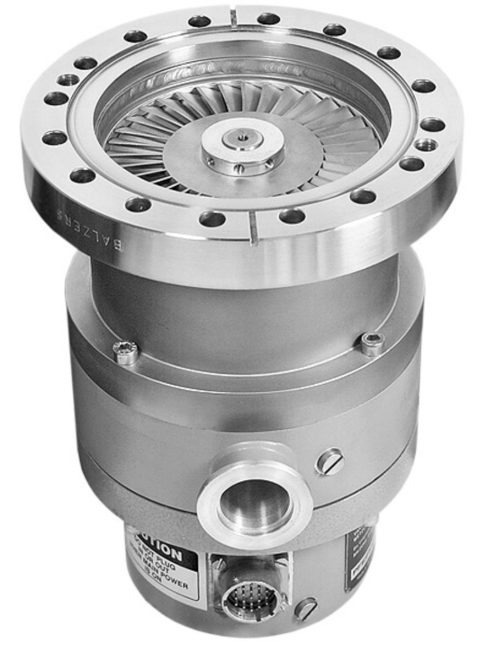
Reflection
Pumping / absorption
S [m³/s] = sticking [0..1] * 1/4 * A [m²] * vavg [m/s]

Slide 8
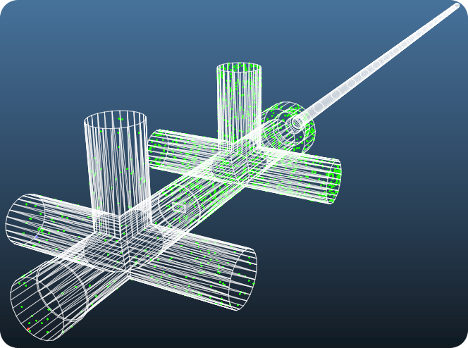
Collecting statistics

Slide 9
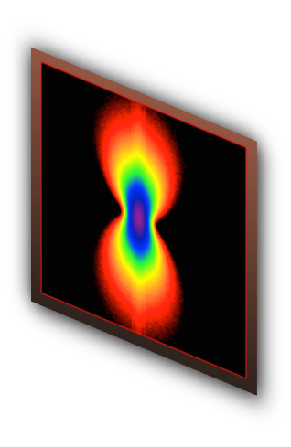
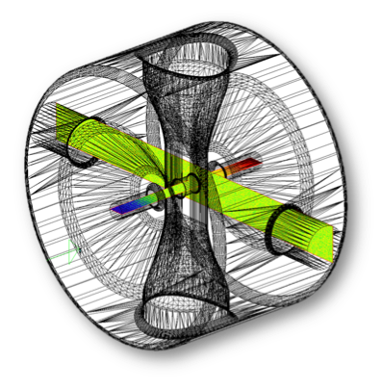
MolFlow+
SynRad+

Slide 10
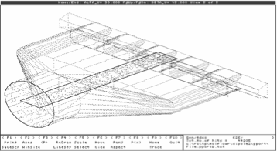
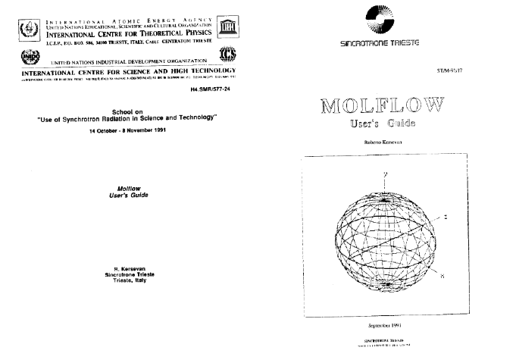
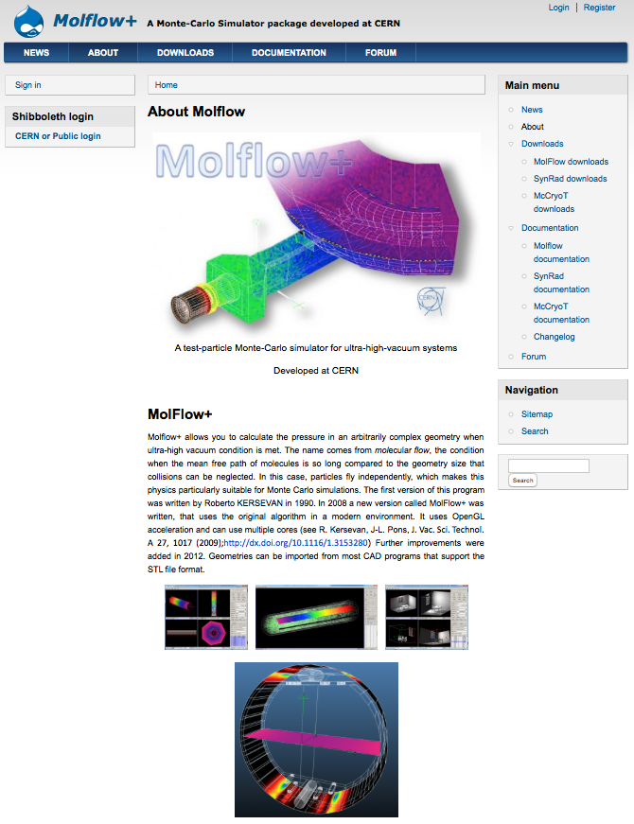
Molflow (1990)
Molflow+ (2008-)
Roberto Kersevan
molflow

Slide 11
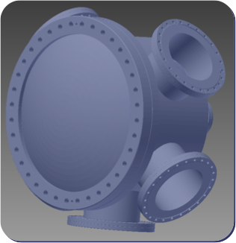
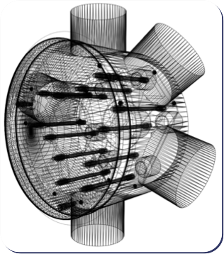
WORKING WITH MOLFLOW
Step 1: creating geometry
CAD
Molflow+
STL format

Slide 12
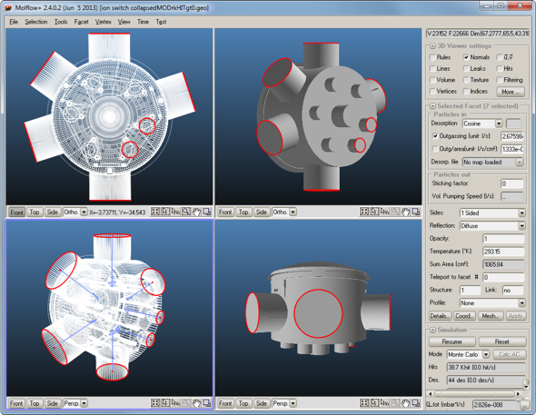
WORKING WITH MOLFLOW
Step 2: adding physics

Slide 13
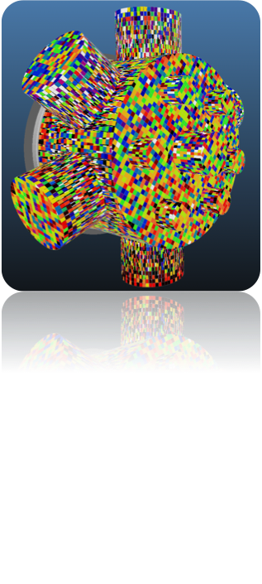
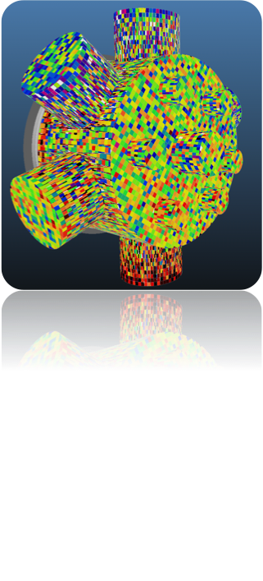
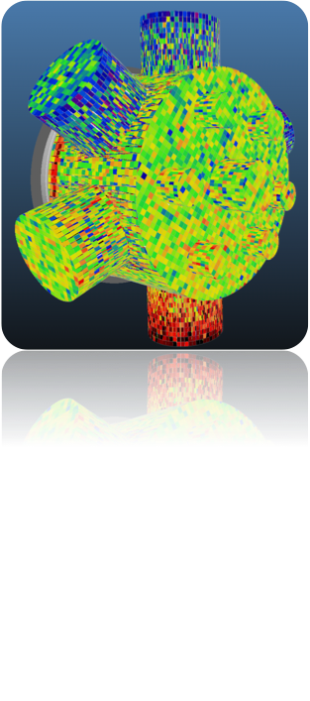
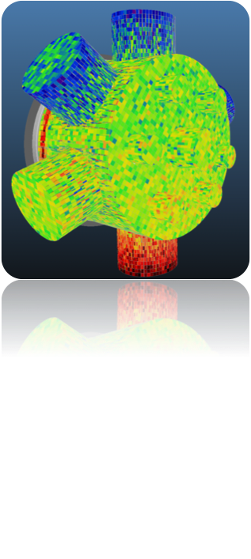
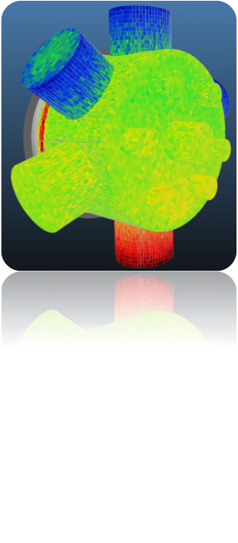
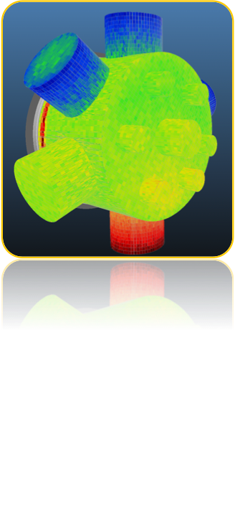
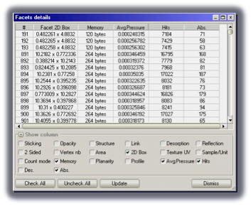
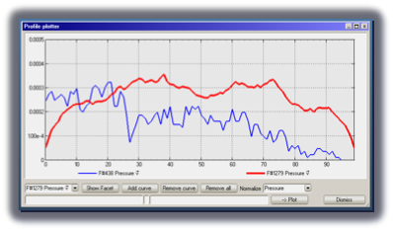
WORKING WITH MOLFLOW
Step 3: simulation and results

