Slide 1
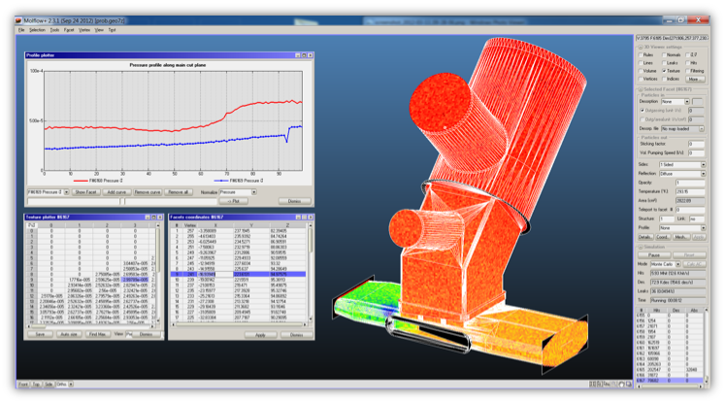
Gas simulations with Monte Carlo methods
CERN Accelerator school – Glumslöv, Sweden
6-16 June 2017, Roberto Kersevan, Marton Ady

Slide 2
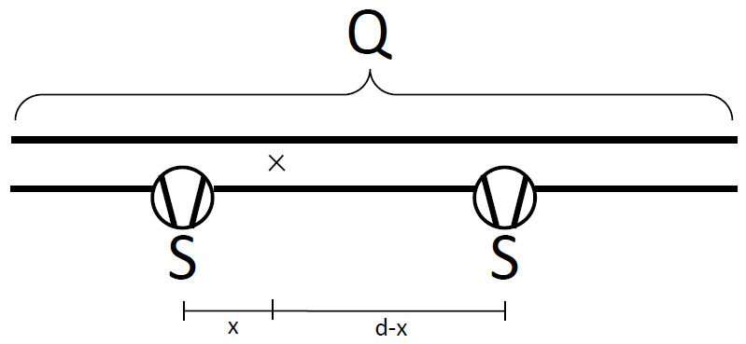
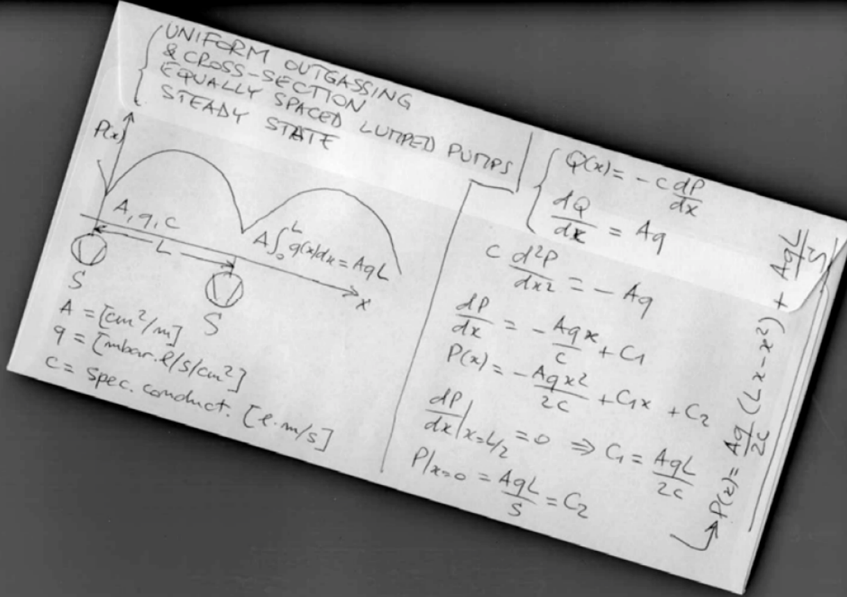
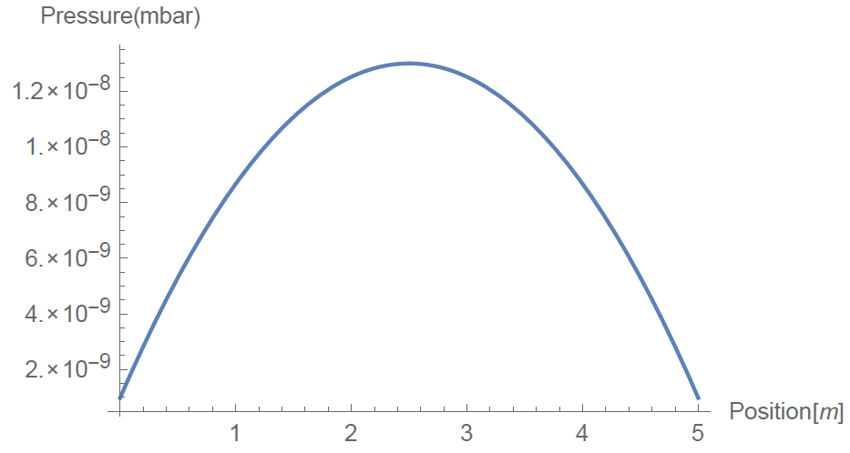
Analytic methods
Gas input
Pumping speed
p=Q/S
Q=C*dp
Pressure
Gas throughput
Conductance
Pressure difference

Slide 3
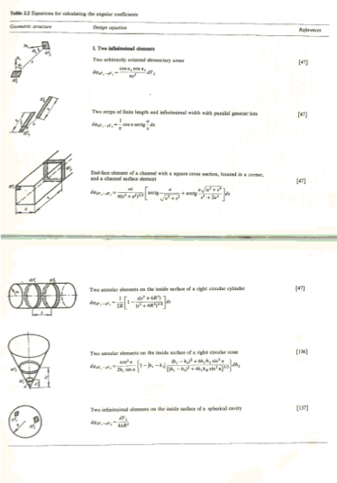
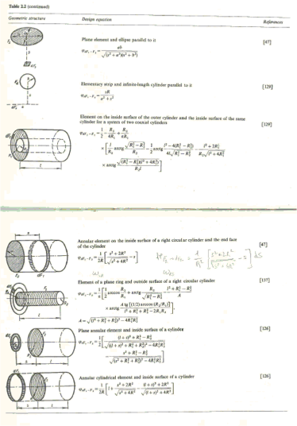
Difficulty: Conductance

Slide 4
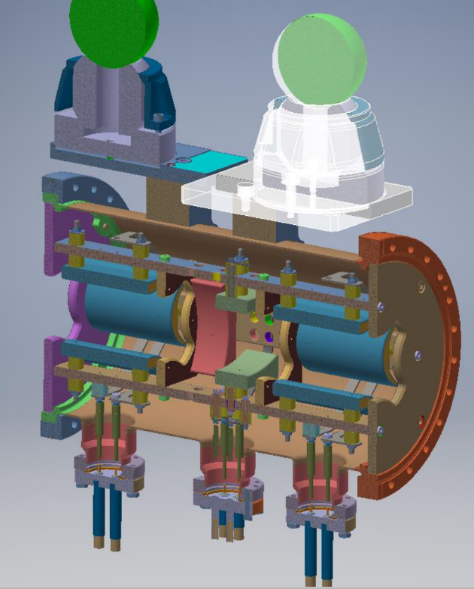

Slide 5
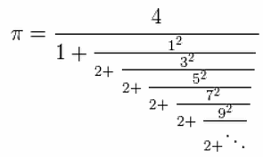
The idea: Monte Carlo method
Circle
R=1
Area=3.14

Slide 6
Monte Carlo
$$\frac{\text{points} \text{inside}}{\text{all} \text{points}}∼\frac{\text{circle} \text{area}}{\text{square} \text{area}}=\frac{π}{4}$$

Slide 7
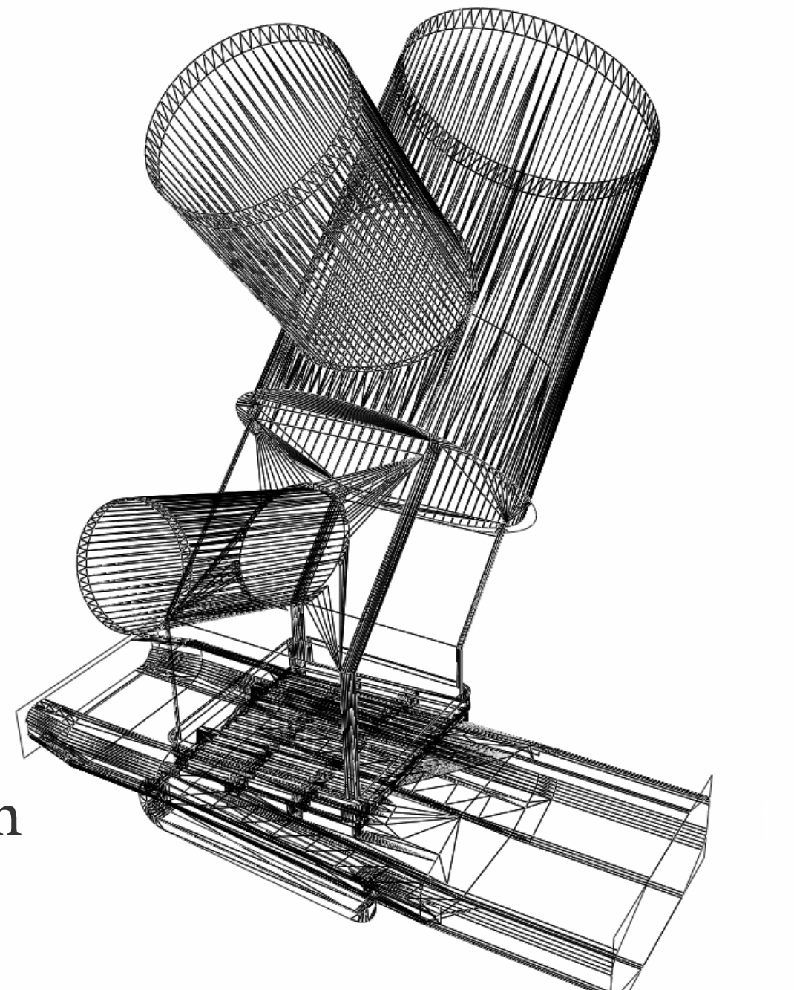
Monte Carlo simulations
Geometry: polygons
Gas input:
pV=NkT
1 Pa*m³/s = 2.4*10²⁰ molecules/s
Virtual / Physical particle ratio

Slide 8
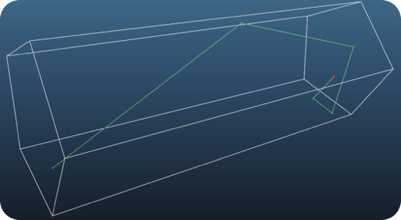
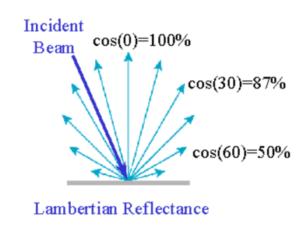
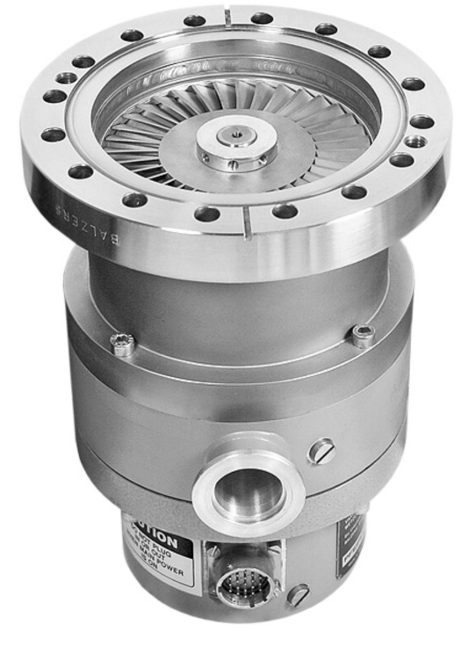
Reflection
Pumping / absorption
S [m³/s] = sticking [0..1] * 1/4 * A [m²] * vavg [m/s]

Slide 9
Monte Carlo
Entrance
Exit

Slide 10
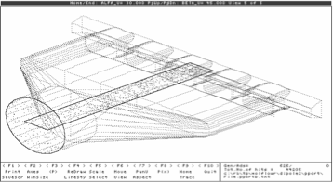
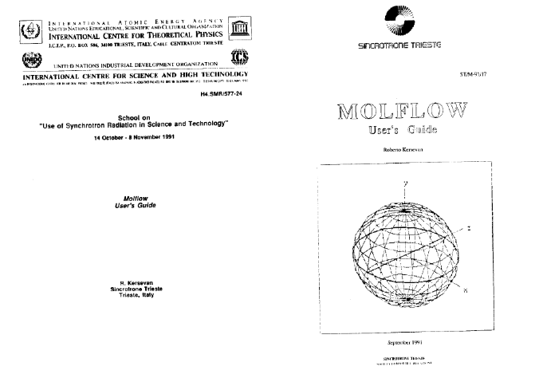
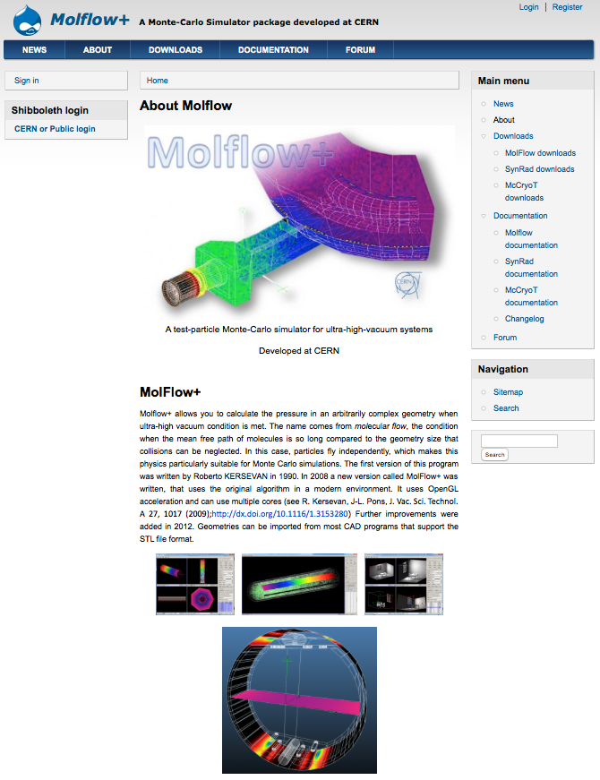
Molflow (1990)
Molflow+ (2008-)
Roberto Kersevan
molflow

Slide 11
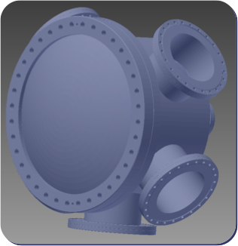
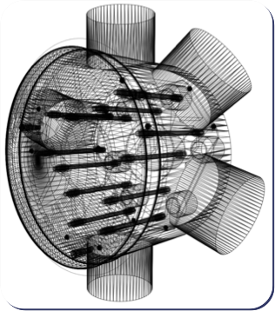
WORKING WITH MOLFLOW
Step 1: creating geometry
CAD
Molflow+
STL format

Slide 12
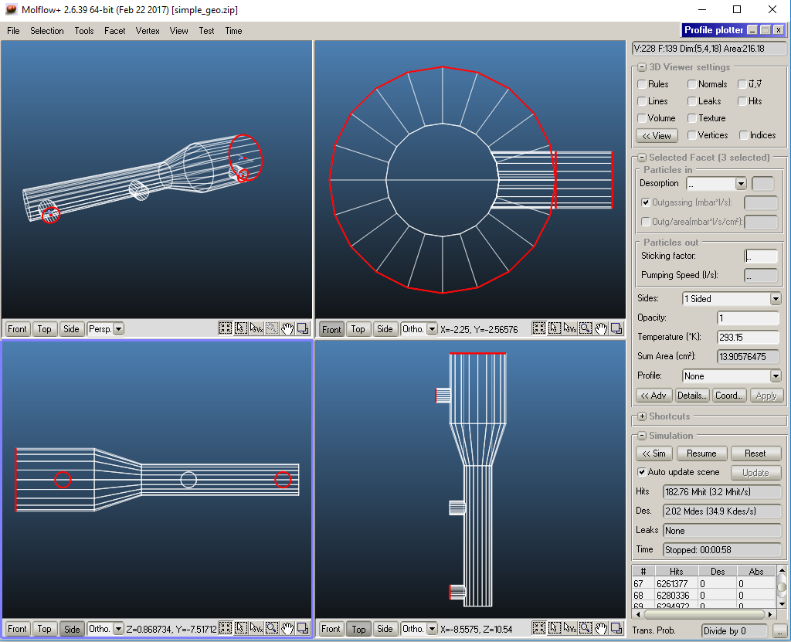
Step 2: adding physics

Slide 13
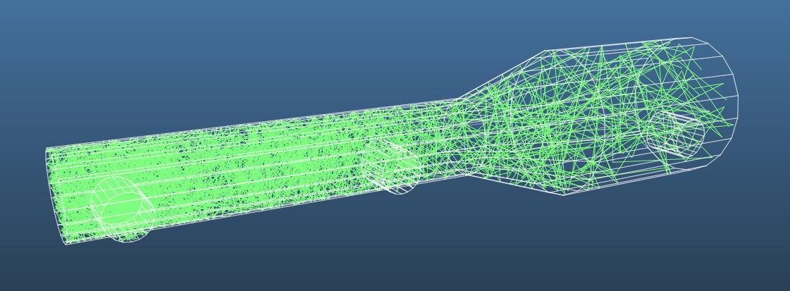
WORKING WITH MOLFLOW
Step 3: simulation and results

Slide 14
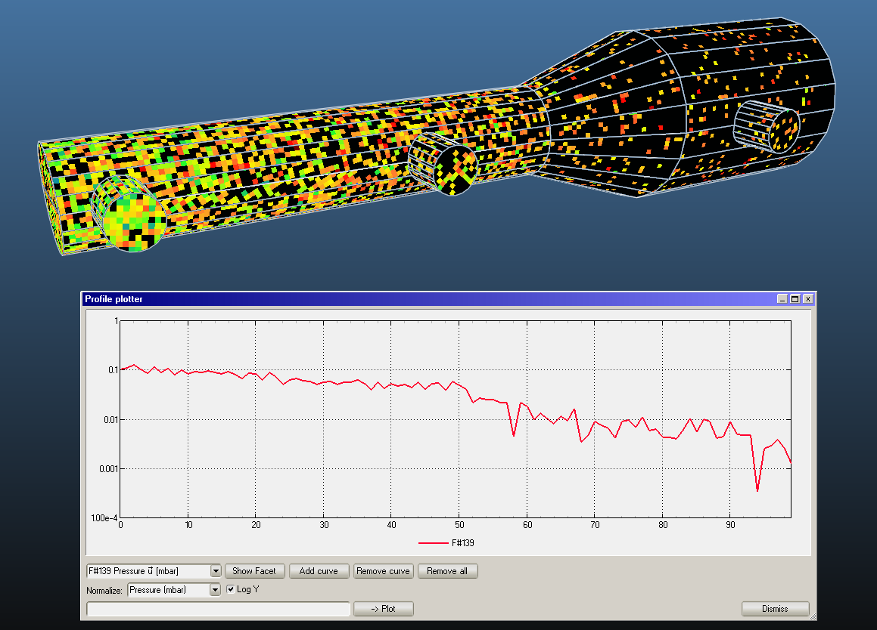
100 molecules

Slide 15
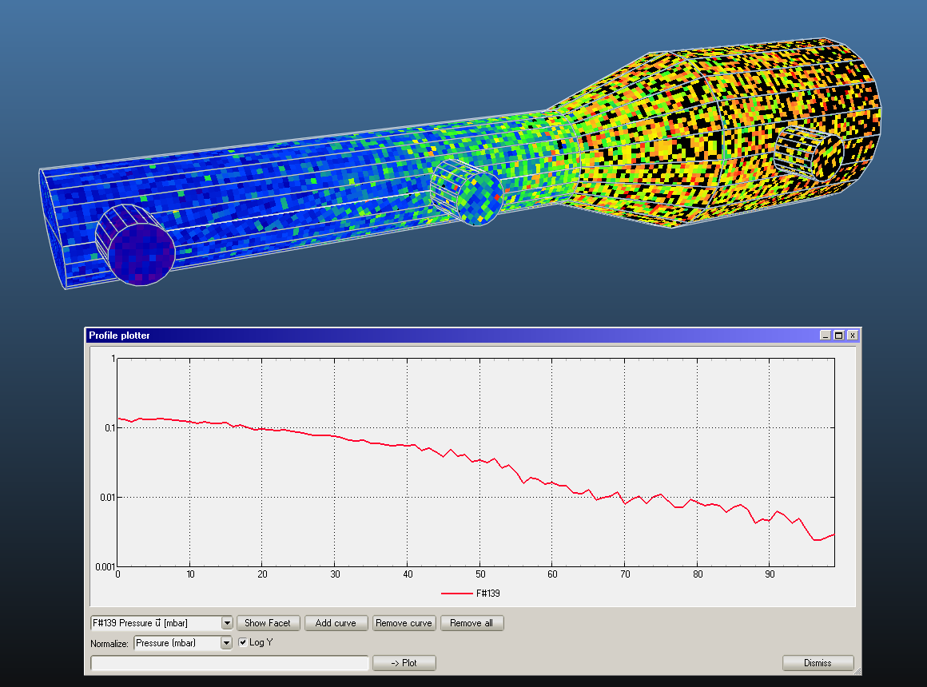
1000 molecules

Slide 16
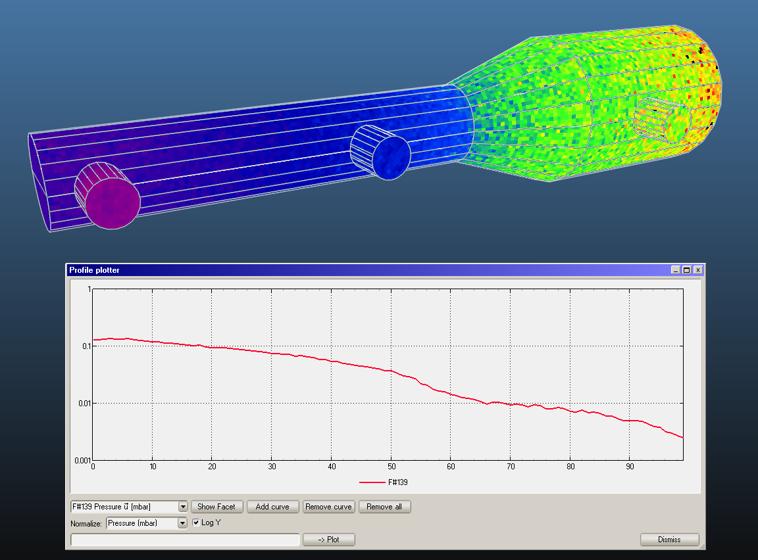
10k molecules

Slide 17
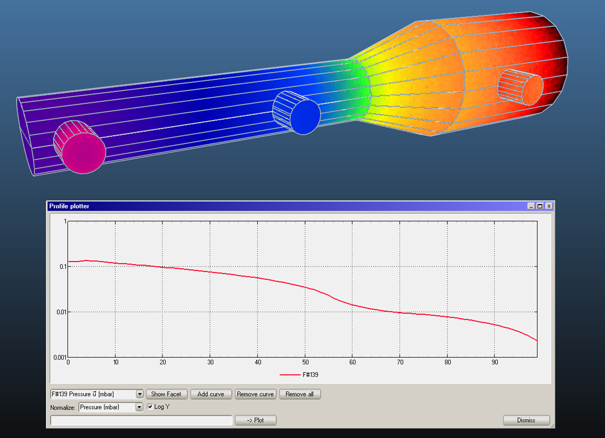
100k molecules

